Slide 1
STUDENT ACADEMY

Slide 2
PROBLEM STATEMENT
Generally students go through a lot of activities in their academic career.
We came up with an idea to compound some of such activities under one website named Student Academy.

Slide 3
PROPOSED SYSTEM
Student Academy is a compact website where mostly all academic needs of a student can be fulfilled such as applying for campus placements, browsing books in library, knowing about the latest workshops and conferences, uploading weeks schedule as a To-do list, shopping books online and also browsing all student friendly websites.
It also provides all academic books PDF’s.

Slide 4
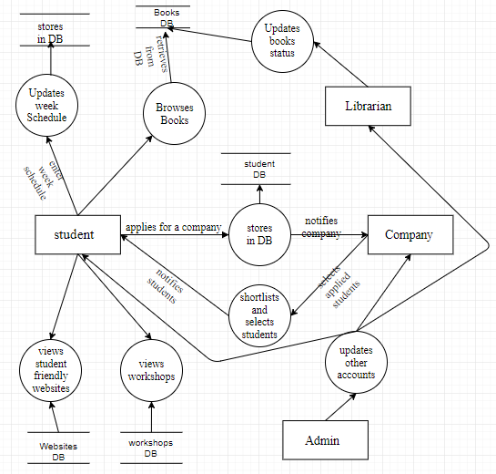
DFD

Slide 5
MODULES
Student Module
Admin Module
Librarian Module
Company Module

Slide 6
STUDENT MODULE
Applies for company
Browses books online
Views workshops and conferences
Updates weeks schedule
Checks for books availability in library
Downloads books(PDF format)
Browses student friendly websites
Uploads C.V.

Slide 7
ADMIN MODULE
Updates/Deletes student and company account
Adds/Removes Librarian account
Updates workshops and conferences
Adds student friendly websites
Updates books shopping sites
Updates Notification bar
Adds books PDF’s

Slide 8
COMPANY MODULE
Specifies posts requirements
Views applied students
Shortlists applied students
Views students C.V.
Selects shortlist students and proceeds to further rounds

Slide 9
LIBRARIAN MODULE
Updates the status of the books in library
Adds new books

Slide 10
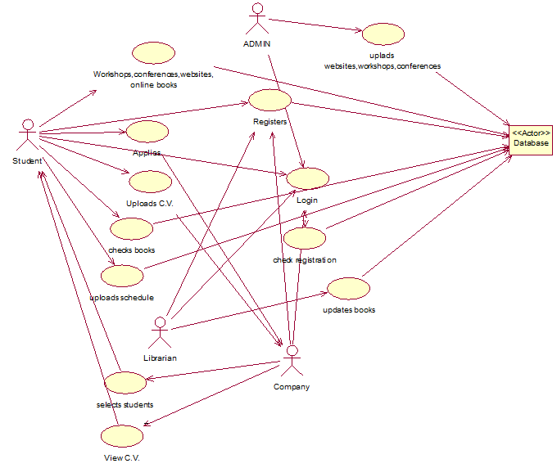
USE-CASE DIAGRAM

Slide 11
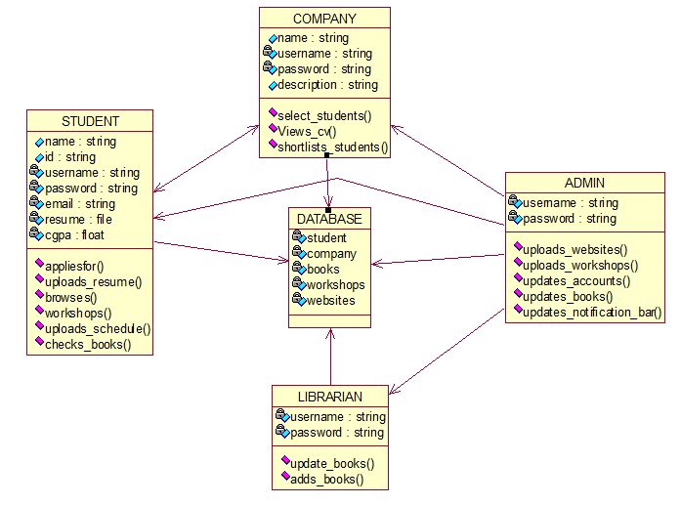
CLASS DIAGRAM

Slide 12
CODING
Coding has been done totally in JavaScript ,JQuery, HTML and CSS.
Nearly we have written around 70 jsp files along with 2 connectors for the total project.
For storing data we used sqlyog.
Software used is NetBeans
Server used is GlassFish Server

Slide 13
HARDWARE REQUIRMENTS
Hardware | Requirements
Processor | Processor which supports browser
RAM | 512 MB
Hard Disk | 50 MB

Slide 14
SOFTWARE REQUIRMENTS
Softwares Used | Description
Operating system | We have chosen Windows operating system for its best support and user-friendliness.
Database | To save the Student, company, books, websites, weeks schedule records we have chosen SQLyog database.
JavaScript, HTML, CSS, SQL | To implement the project we have chosen JavaScript language for its more interactive support.
JDBC | For Connectivity to Database

Slide 15
CONCLUSION

